Slide 1
Python Libraries

Slide 2

Graphing with matplotlib

Slide 3
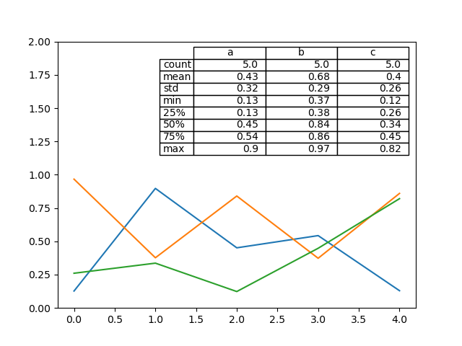
Why is Plotting important?
The Matplotlib library in python is a powerful data analysis tool that can be used to visualize data
Which is more intuitive - table or graph?

Slide 4
Getting started
We will make use of the matplotlib.pyplot library
import matplotlib.pyplot as plt
This is like importing any other library
Like numpy, we import it as something else to make calling functions easier

Slide 5
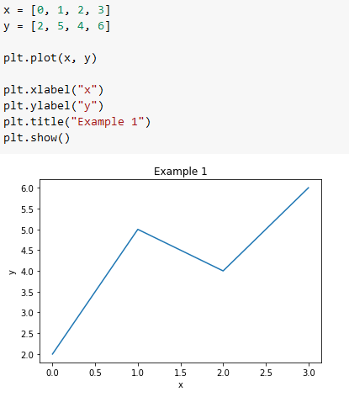
Making a basic graph
Essential components:
X and Y points
plt.plot(x, y)
plot.show() to display the plot
Also very important for clarity
plt.xlabel()
plt.ylabel()
plt.title()

Slide 6
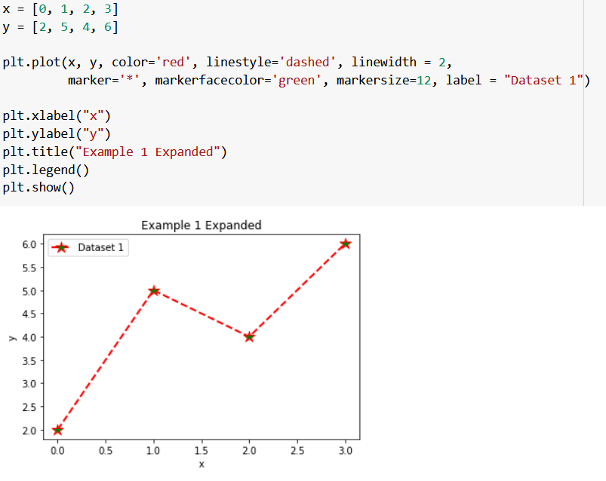
Customizing Graphs
Many ways to customize graph output in plt.plot() function
Color = change line color
Linestyle -change line style
Linewidth - change line width
Marker - change point marker
Markerfacecolor - change marker color
Markersize - change maker size
Label - label for legend
Just add the after x,y
Additionally, to add a legend, be sure to add plt.legend() to your code
Helpful when graphing multiple functions!

Slide 7
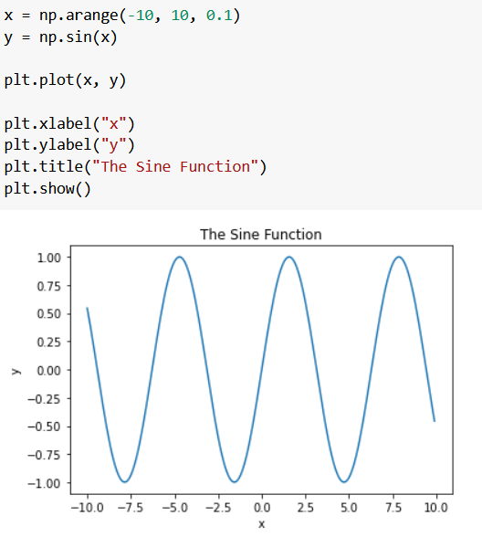
Graphing a function
Use np.arange(start, stop, step) to create x
y = f(x)
Label your graphs!

Slide 8
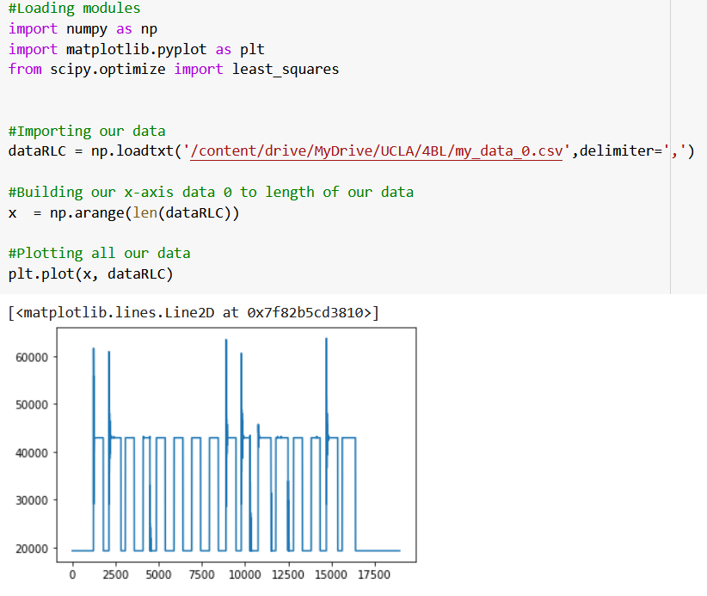
Graphing outside data
You can import outside data using numpy and use its splicing functions to get x and y for matplotlib analysis!
Note: Delimiter is what separates data points with the imported file, comma for .csv files

Slide 9
Happy graphing!

Slide 10


Intro to pandas
Bruce Qu
Junior in Electrical Engineering

Slide 11


Three challenges:
First Challenge: Why do we need it? Can’t we just use Numpy?
Second Challenge: How to use pandas? Is it hard?
Final Challenge: What is pandas?

Slide 12
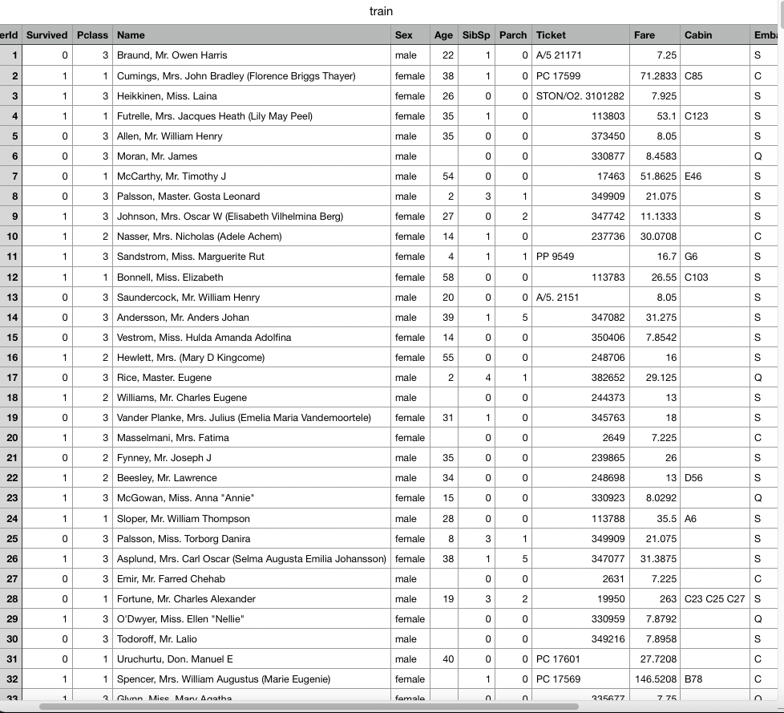

A little thought experiment…
csv(comma separated values) file
Here is an Excel file. Take a look at this! And provide some insights!
Titanic data website: https://www.kaggle.com/competitions/titanic/data

Slide 13
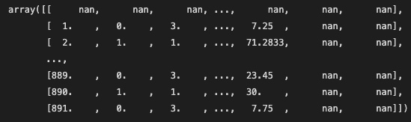
A little thought experiment…
You decided to use Numpy, and this is the output that you get…
Hmmm.. I forgot the ‘Age’ value for the 566th passenger. Could you look it up for me?
AN ARRAY !!!

Slide 14
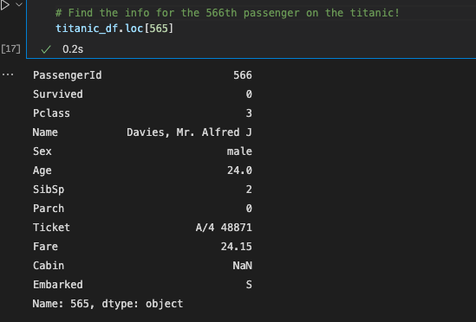
A little thought experiment…
Now you followed your colleague’s advice, and used pandas….
Hmmm.. I forgot the ‘Age’ value for the 566th passenger. Could you look it up for me?

Slide 15

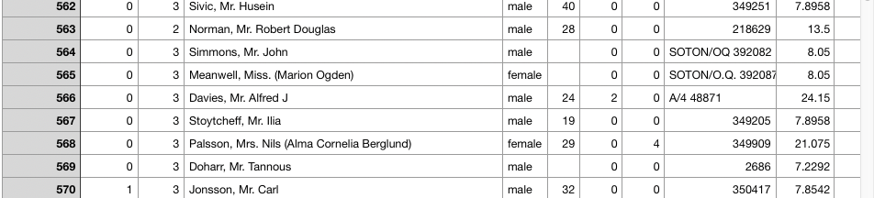
A little thought experiment…
Now you might be wondering: Why not just use Excel? Wouldn’t that be faster?
Answer: Yes! And you don’t need to write code. BUT that’s the NORTH campus way.

Slide 16
Well, if Numpy is so complicated, why don’t we just use Excel???
Flexible:
Graphs are much more customizable and you can create pretty much any concept you want with pandas.
It works pretty well with Python and other libraries such as tensorflow.
Powerful:
Good at automating the clean up of datasets (e.g. missing values)
Arithmetic operations friendly, fast if you are fluent.
However, I wouldn’t say which one is better than the other. I wouldn’t use pandas to browse data.
The most important thing:
Writing code is cool and fun!!!

Slide 17

Now you should be able to answer the first question from Po:
First Challenge: WHY do we need pandas?
Destroy dumplings???

Slide 18
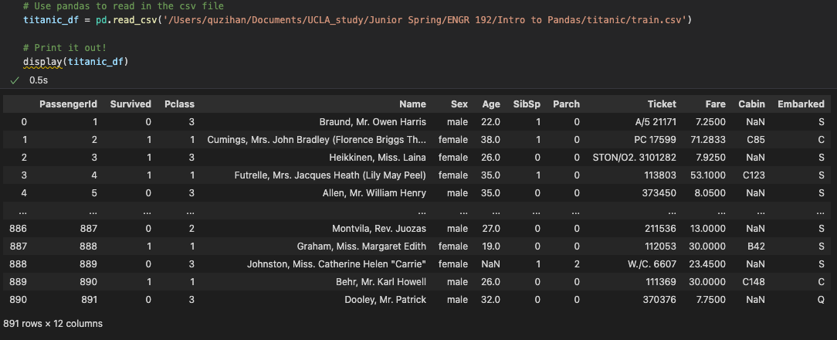
Okay… But how to use pandas???
Input Area
Read-in Data
Display Data
Output Area

Slide 19
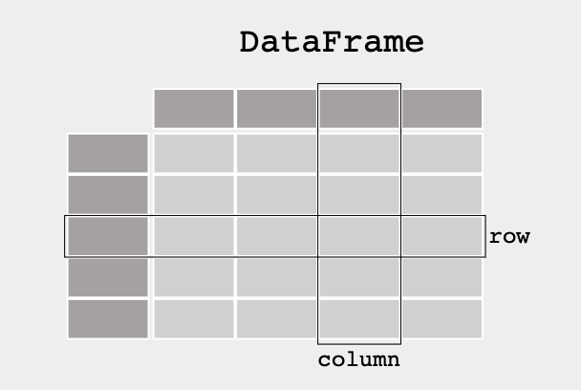
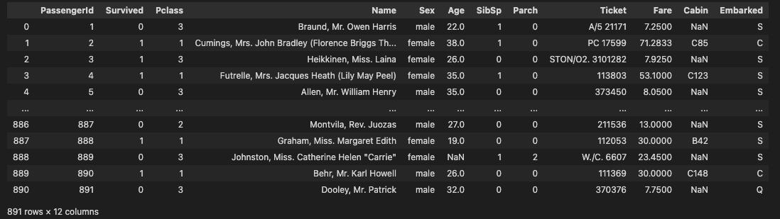
DataFrame Overview
In pandas, a data table is called a DataFrame.
And like any table, a DataFrame has rows and columns
To take full advantage of pandas and DataFrame, you
need to be good at manipulating rows and columns.

Slide 20

DataFrame in action!!!

Slide 21


It looks pretty simple!!!
But similar to mastering all skills, becoming a Pro Pandas takes a lot of TIME and EFFORT.

Slide 22

Some Useful functions in pandas
My birthday is in the ‘B’ column, and it’s on the second row!!
df.head() : Show the top 5 rows
df.tail(3) : Show the last 3 rows
df.index : Display the index
df.columns: Display the columns
df.describe(): shows a quick statistic summary of your data:
….
In class challenge:
Please read the “Selection by label” section in “Selection” and help Po find his Birthday!
Go to: https://pandas.pydata.org/docs/user_guide/10min.html#selection

Slide 23

Titanic Lab! Practice makes perfect
Detective Po: “ Can you show me all the columns that you have?”
Detective Po: “ Show me the top 10 rows of your DataFrame”
Detective Po: “ I don’t really need the ‘Ticket’ column, can you drop it?” (Hint: df.drop())
Detective Po: “Can you give me all the information about a passenger called ‘Quick, Miss. Phyllis May’ ?”

